Slide 1
Entity Relationship Modeling
CT004-3.5-3
Advanced Database Systems

Slide 2
Learning objectives
At the end of the lecture, you should be able to know
How to model of real world
    Entities, Attributes & Relationship
    ER Diagram

Slide 3
Entity Relationship Diagram (ERD)
An entity relationship diagram is a graphical representation of an organization’s data storage requirements.
Entity relationship diagrams are abstractions of the real world that simplify the problem to be solved while retaining its essential features.

Slide 4
Entity Relationship Diagram (ERD)
ERDs are used to:
  identify the data that must be captured, stored and retrieved in order to support the business activities performed by an organization; and identify the data required to derive and report on the performance measures that an organization should be monitoring.

Slide 5
The ‘data’ view of a system may be modeled by an Entity-Relationship Diagram (E-R Diagram).
Provides a high-level, conceptual view of a DB structure.

Slide 6
Components of ERD
Entity Relationship Diagrams have three different components:
  ENTITIES
  ATTRIBUTES
  RELATIONSHIPS

Slide 7
Entities
These are the people, places, and things exist in
an organization. In short, anything which an organization needs to store
data about.
An actual, real thing or person about which data
might be stored is referred to as an entity.
An entity can be uniquely identified.
Organisations collect and store data about entities:
  if a bank stores data about you - you are an entity
  if a business stores a piece of paper called an invoice - the invoice is an entity
  a library stores data about a particular book - the book is an entity

Slide 8
Attributes
Entities are further described by their attributes (sometimes called data elements). These are the smallest units of data that can be described in a meaningful manner.
An attribute is a data element associated with an entity.
The entity type SUPPLIER is likely to have attributes such as:
  supplier_name
  supplier_address etc.

Slide 9
Selecting Entities:
Deciding upon entities is not always an easy process.
The danger is in identifying attributes as entities and vice versa.
Try and identify nouns in the narrative and decide whether or not data is likely to be stored about them.

Slide 10
Example
Each engineer is allocated one van (which is driven up to a certain mileage and then replaced). Each member has only one address but perhaps many vehicles. Each visit is to deal with only one vehicle. A member can be visited more than once on any given date and there may be many visits to a member on different dates. A member may only be covered for some of the vehicles they own and not for others.
From the above what are likely entities and attributes?

Slide 11
The nouns are:
    engineer, van, mileage, member, address, vehicle, visit and date.
Entities:
    engineer, van, member, vehicle, visit.
Attributes
    mileage (van)
    address (member)
    date (visit)

Slide 12
Relationships
Entities are associated with each other via relationships.
A relationship is a named association between two or more
entity types.
The relationship PLAY-FOR between the entity types
PLAYER and TEAM.
  The relationship CITIZEN-OF between the entity types PERSON and COUNTRY
  EMPLOYEEs work in a DEPARTMENT
LAWYERs advise CLIENTs
EQUIPMENT is allocated to PROJECTs

Slide 14
Types of Relationships
There are potentially three types of relationship that can exist between two different entities:
  One-to-One Relationships
  One-to-Many Relationships
  Many-to-Many Relationships

Slide 15
Types of Relationships
One to One Relationship(1:1)
This type of relationship takes place when a single occurrence
of an entity is related to just one occurrence of a second entity.
The relationship HEAD-OF between entity types MANAGER and
DEPARTMENT.
This means that a department has at most one head and that manager is head of at most one department.
Notes:
Semantic net used for clarification

Slide 16
One-to-Many Relationship(1:M)
This type of relationship takes place when a single occurrence
of an entity is related to many occurrences of a second entity.
The relationship SUPERVISES between the entity types
MANAGER and EMPLOYEE.
This assumes that a manager may supervise any number of different employees but a given employee is supervised by at most one manager.

Slide 18
Many-to-Many Relationship (M:N)
This type of relationship takes place when many occurrences of an entity are related to many occurrences of a second entity.
The relationship ASSIGNED-TO between the entity types EMPLOYEE and PROJECT.
An employee may be assigned to many different projects and each project may have many employees assigned to it.

Slide 19
Notation
A plain rectangle is used to
represent the entity type.
INVOICE
is sent by
A labeled line to represent the
relationship.
A
B
1 : 1
A
B
1 : N
Notes:
This is Information engineering notation

Slide 20
Examples
COURSE
has enrolled
STUDENT
ONE course has enrolled on it ONE or MORE students.
many students are enrolled on ONE course.
LOAN
refers to
BOOK
ONE loan refers to ONE book.
ONE book is referred to on ONE loan.

Slide 21
Many-to-Many Relationship Example
Relational databases cannot support this relationship type.
These relationships imply a missing or link entity.
Suppose investigation and analysis has shown that:
  any one supplier might supply more than one kind of part.
  any one kind of part might be bought in from a number of different suppliers.
SUPPLIER
supplies
PART

Slide 22
Many to Many Example Cont’d
The many-to-many relationship type is removed as follows:
SUPPLIER
PART
X

Slide 23
Many to Many Example Cont’d
Thinking of an appropriate name for entity ‘X’ can be difficult.
In such cases it is acceptable to form it from the names of the original two entities.
SUPPLIER
PART
SUPPLIER_
PART

Slide 24
Guidelines for Drawing an E-R Diagram
Select likely entities.
Select an identifier for each of the entities.
Produce an entity relationship grid.
Identify relationships between the selected entities.
Sketch an E-R Diagram based on the above.
Decompose any N:M relationships. (If N:M relationships are present, 2 ERDs will be required.)

Slide 25
Example
Simple Hospital System
In a hospital system, each ward has many patients who
are cared for by nurses assigned to the ward. Patients
may have more than one disease, thus requiring
treatment by more than one specialist doctor.
Draw an ERD for the simple hospital system.

Slide 26
ERD Example –
Simple Hospital System
WARD
DOCTOR
has
accommodates
assigned
treats
NURSE
PATIENT
Disease
cares
for
suffers
from

Slide 27
Example
  Small College Database
A small college database has the following structure.
A department has many lecturers. A lecturer belongs to only one department. The department offers many different courses, and many lecturers can teach on a single course. Lecturers can also teach on more than one course. Many students enrol for many courses.
Draw an ERD for this system.

Slide 28
Small College Database
DEPARTMENT
is_in
offers
COURSE
LECTURER
teaches_on
enrols
STUDENT

Slide 29
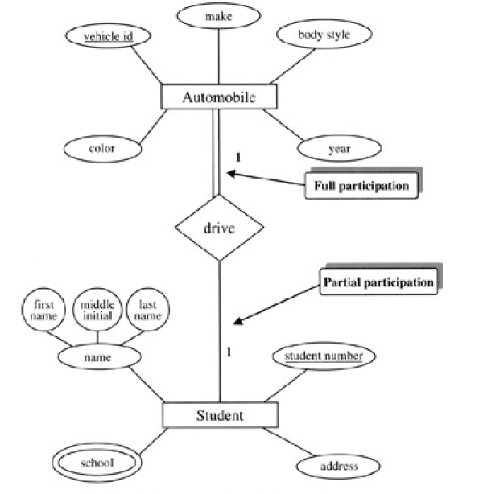
Example of Chen Notation

Slide 30
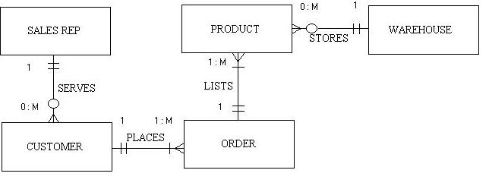
Example of Crow’s Feet Notation

Slide 31
Q & A

